Slide 1
NEXGEN EDUCATION
Problem Statement Title: Future Of Education
Team ID: L1T3
Team Leader: Hitanshu Atul Shah
College Name: Atharva College of Engineering
Nexgen Education:
It is a website which provides the students of the college with various services and information regarding their academic activities.
It gives access to students to create their account and view their schedule and attendance and timely view the lectures whenever needed.
Learning education relevant to each student and flexible for students.
Additional feature of live lecture is provided to all the users.
Study materials and other essentials of all branches and of every year can be provided under a single website only.

Slide 2

Description of Idea / Proposed Solution:
The idea behind the development of the website is to provide all the resources available to the students for the betterment of their education and knowledge.
The education system as of now can be improved using various technologies that are available to us and can be used to make more efficient system.
To make the future of education more efficient we have merged all the academic information and engineering syllabus of all branches of every year under a single source.
Along with that we also provide information and links to the certified courses websites under a single source which can be useful for personality development purpose.
The main problem suffered by the students is that by some or other reason they are not able to attend all lectures or miss certain lectures.

Slide 3
Description of Idea / Proposed Solution:
Hence we also provide an option to attend live lectures that is if someone is running late they can stream the lecture directly on their devices.
Also along with that if someone wishes to revise certain topics again then we also provided with an option of Recorded lectures in which all lectures are uploaded so the student can watch the lecture according to his/her specific branch and year.
By doing so we can make sure that all the study related sources are available to the Students easily.

Slide 4
Use case Diagram
Attendance
SignUp
Login
Recorded
Videos
USER
Live Lecture
Streaming of
live lecture
Study Material
Can view reference book
Online Courses
Can access various websites
Became Teacher
Can Upload Videos
Register
About Us

Slide 5
Description of Technology Stack & Dependencies
* For executing our code we used Sublime text as a text editor.
* For creating the webpage we used Hyper Text Markup Language (HTML).
* For styling the web page we used Cascading Style Sheets (CSS).

Slide 6
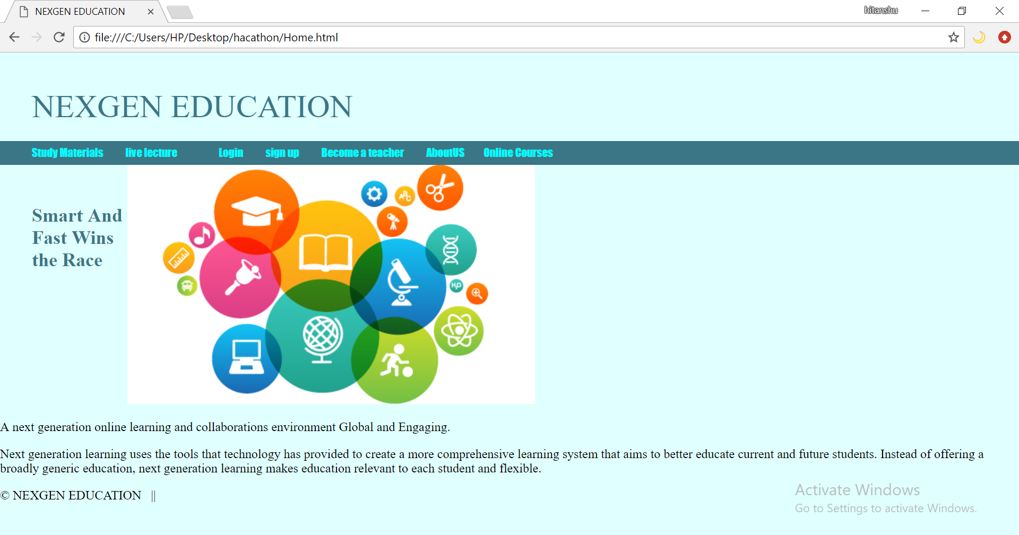
Prototype
Visualize the Working of your Prototype ( Screenshots/ Working Algorithm):
Home Page:-

Slide 7
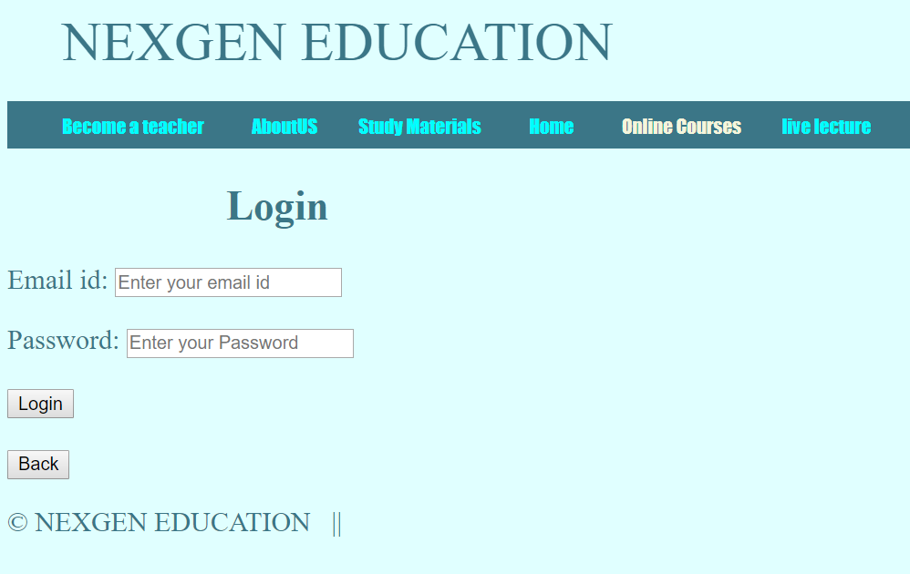
Login Page:-

Slide 8
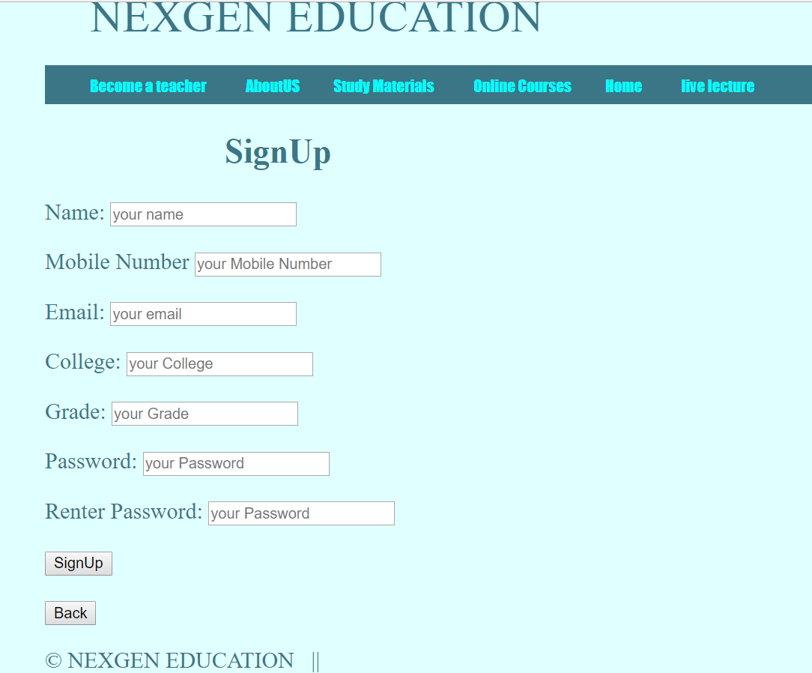
SignUp Page:-

Slide 9
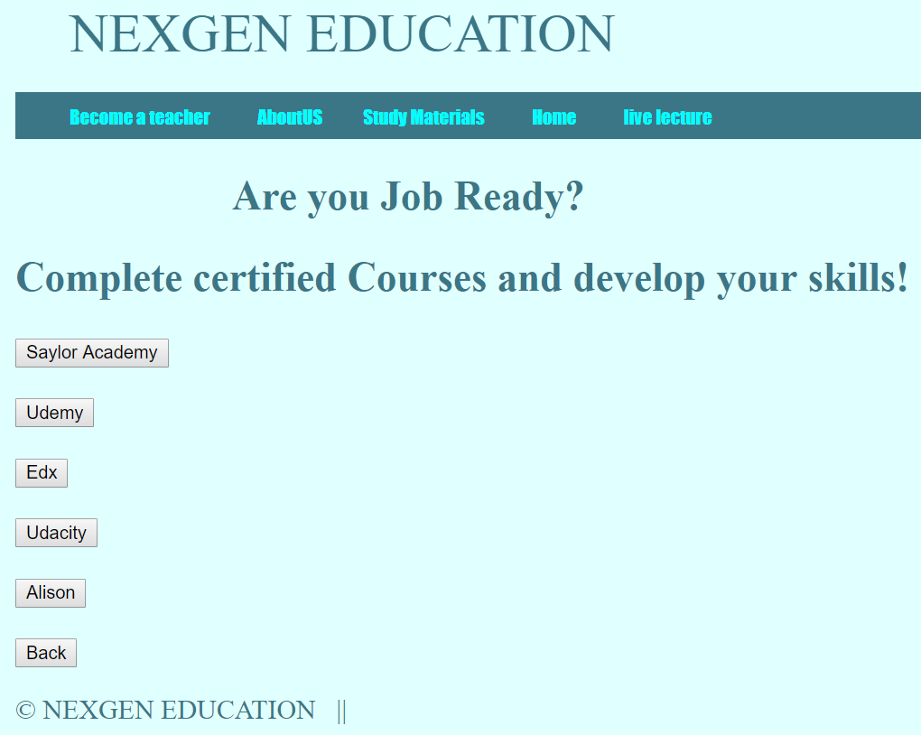
Online courses Page:-

Slide 10
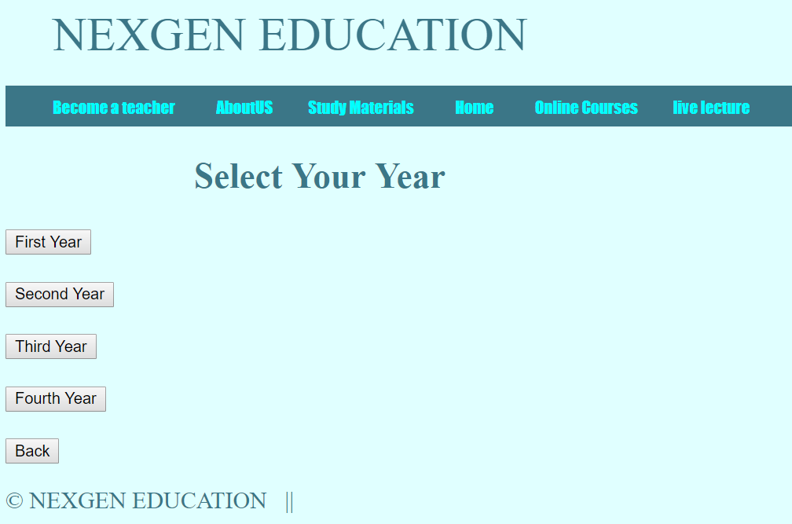
Engineering Year Page:-

Slide 11
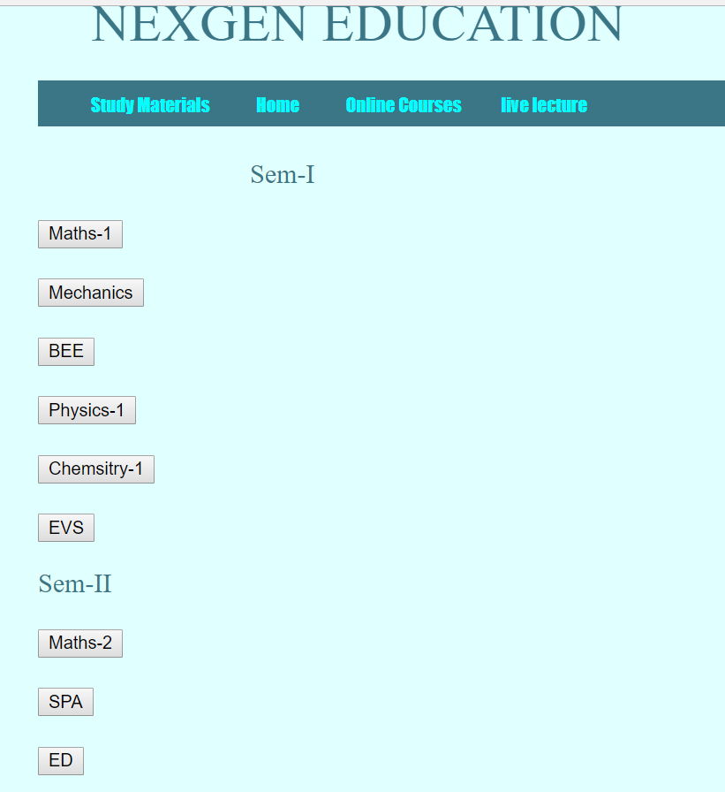
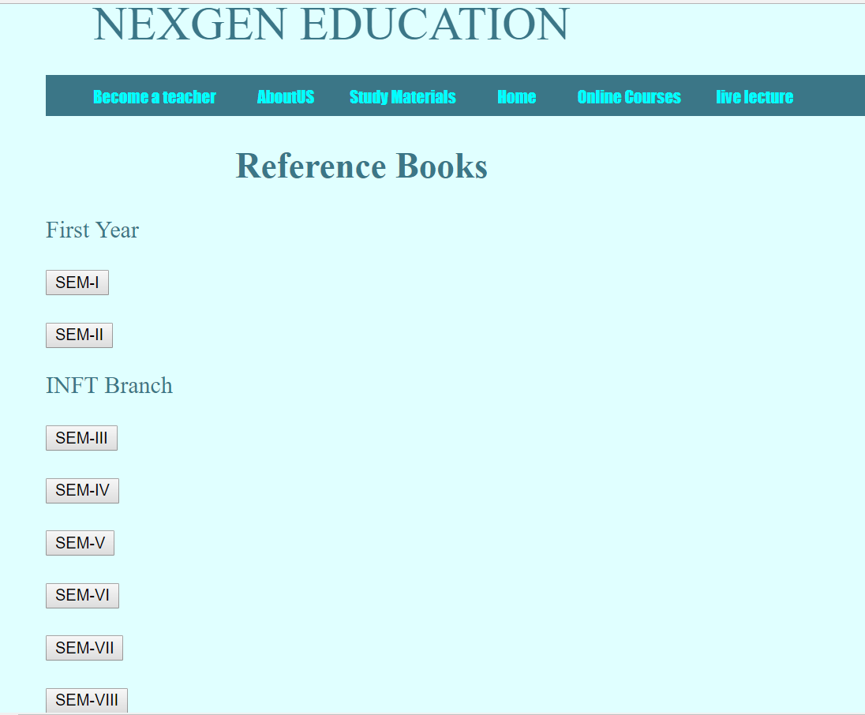
Recorded Videos Page:- Study Materials Page:-

